Slide 2
Lesson 4
min max average storage . Remove letter .
function in function . Calendar of Month problem .
Reverse Cipher

Slide 3
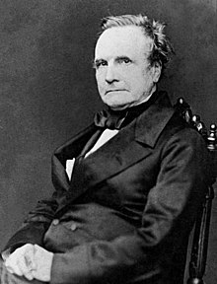
Reminder: Who is Charles Babbage ?
Interesting facts or stories ?
What is his most significant work or contribution to this field ?
Contribute in forum

Slide 4
Example – min, max, average & storage
A group of students had a test (0 – 100) marks.
We want to know the following:
Lowest mark
Highest mark
Average mark
Keep the score of all students

Slide 5
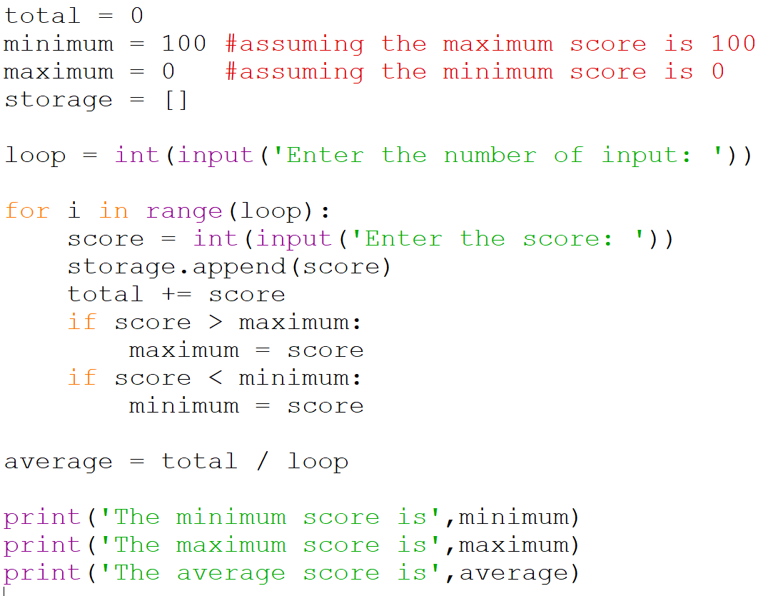
Example – min, max, average & storage
What if you want to stop the program by keying in an empty score.
(another way to implement)

Slide 6
Example - Remove letter in string
Write a function remove_letter(msg,letter) that takes a string msg and a single character letter. This function returns a string, which is msg with all occurrences of letter removed. This function is case sensitive, so ‘A’ is not the same as ‘a’. A sample run is shown below.
>>> message = “a pack of pickled peppers”
>>> remove_letter(message,’p’)
“a ack of ickled eers”

Slide 7
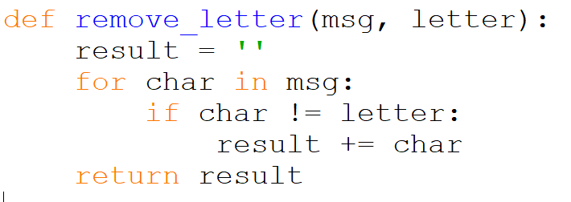
Example - Remove letter in string
What if I want to swap letter and not remove?

Slide 8
let’s think . . . and discuss . . .
def f(g):
return g(2)
def square(x):
return x**2
def mystery(x):
return x * (x + 1)
>>>f(square)
>>>f(mystery)
What is going on ?

Slide 9
function in function
x = 5
y = 10
z = 15
def f(x):
def g(y):
def h(z):
return x + y + z
return h(y)
return g(x)
print(f(6))
What is printed ?

Slide 10
continue and break
The continue keyword causes Python to skip the remaining commands in the loop and go straight to deciding whether the loop should run again by testing the condition after the while keyword.
The break keyword, on the other hand, causes Python to immediately skip the remaining commands and exit the loop completely.

Slide 11
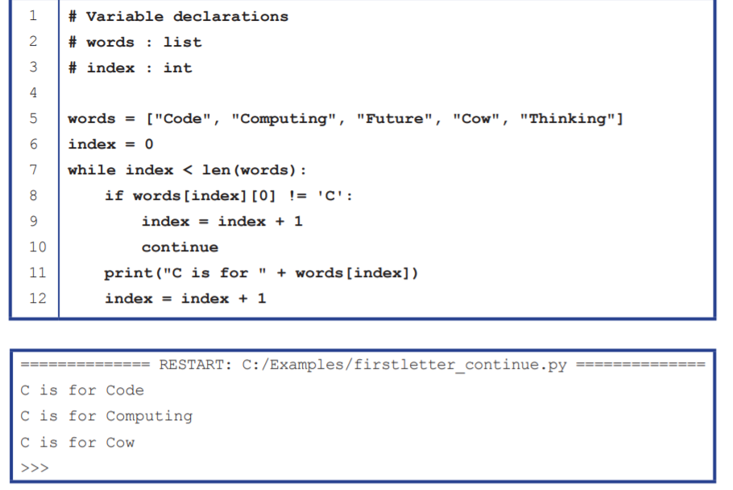

Slide 12
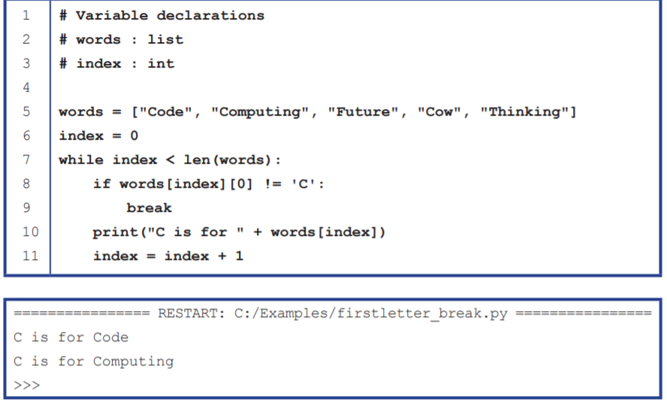

Slide 13
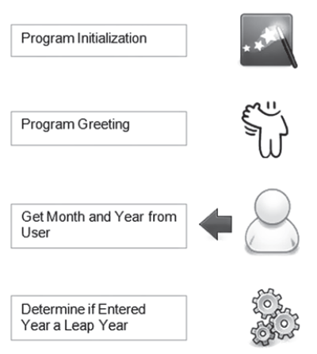
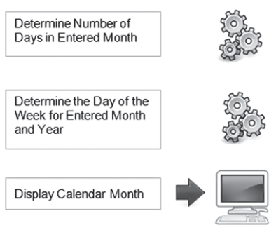
Calendar of month Problem

Slide 14
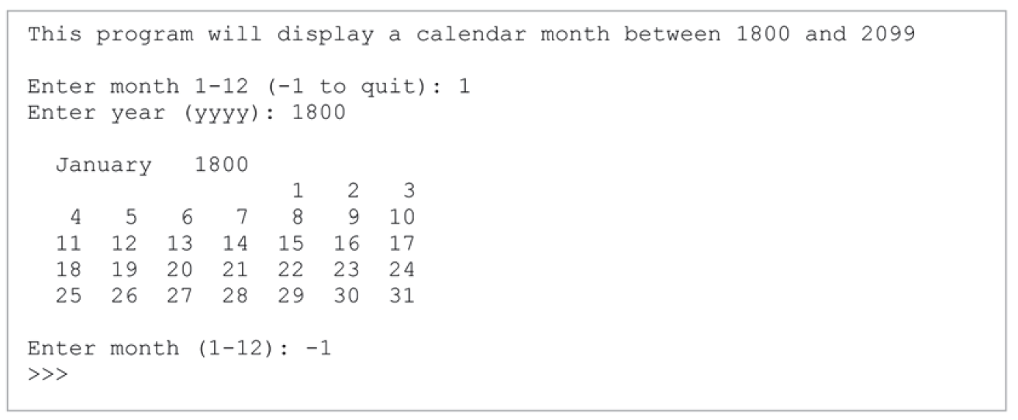
Calendar of month Problem

Slide 15
Cipher
A cipher is an algorithm which can be used to encode a message so that unintended recipients of the message are not able to read it.
Plain Text
The plain text message is the text which is readable and can be understood by all users. The plain text is the message which undergoes cryptography.
Cipher Text
Cipher text is the message obtained after applying cryptography on plain text.
Encryption
The process of converting plain text to cipher text is called encryption. It is also called as encoding.
Decryption
The process of converting cipher text to plain text is called decryption. It is also termed as decoding.

Slide 16
Reverse Cipher
Algorithm of Reverse Cipher
The algorithm of reverse cipher holds the following features −
Reverse Cipher uses a pattern of reversing the string of plain text to convert as cipher text.
The process of encryption and decryption is same.
To decrypt cipher text, the user simply needs to reverse the cipher text to get the plain text.
The major drawback of reverse cipher is that it is very weak. A hacker can easily break the cipher text to get the original message. Hence, reverse cipher is not considered as good option to maintain secure communication channel.

Slide 17
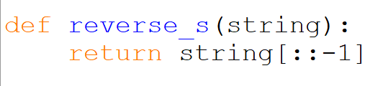
Reverse Cipher
Can you implement this without using the method [::-1] ?

Slide 18
Caesar Cipher
The Caesar Shift Cipher is a type of substitution cipher where each letter in the original plaintext message is replaced by a letter some fixed number of positions down the alphabet.
It is named after Julius Caesar, who used it in his private correspondence.
The table below shows an example where the letters have been shifted to the right by 3.
Note that the letters “wrap-around” at the end.
a | b | c | d | e | f | g | h | i | j | k | l | m | n | o | p | q | r | s | t | u | v | w | x | y | z
d | e | f | g | h | i | j | k | l | m | n | o | p | q | r | s | t | u | v | w | x | y | z | a | b | c

Slide 19
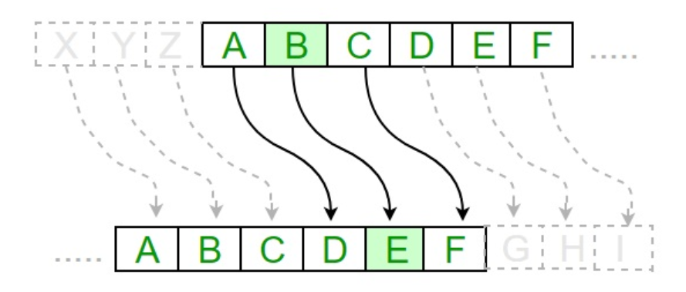

Slide 20
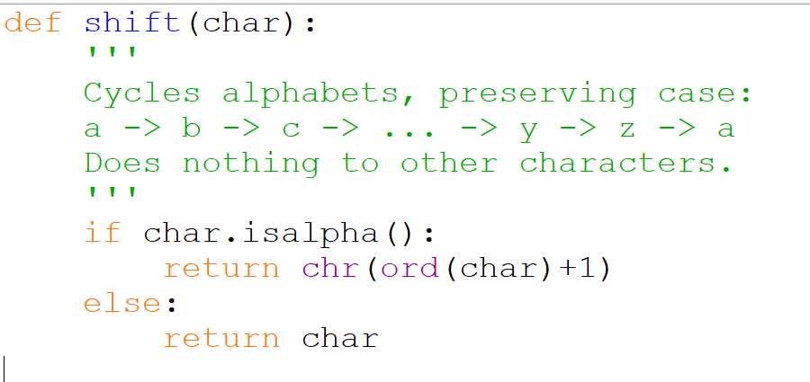
shift in one character
string.isalpha() returns True if is an alphabet, False otherwise
Something is missing !

Slide 21
Work to do . . . . . .
4A – Iteration
Revision 1 (Fundamentals)
Programming Assignment 4
Calendar of Month Problem
Cipher:
Reverse cipher (alternate implementation)
Shift one character

